Slide 1
Project 2
Traffic Prediction analysis
By Brown, Isaiah & Priya.

Slide 2
Objective - We will be focusing on Estimating Delays based on Highway Incidents
Using machine learning to search through historical data of already traveled delivery routes and generate critical insights to boost fleet productivity and reduce costs for freight logistics companies by providing ETA estimates.

Slide 3
Motivation
Before the COVID-19 pandemic, many people took the supply chain for granted. In fact, many people didn’t think of the logistics industry much at all. The New York Times even confessed to not having a logistics newsbeat before the pandemic. Today, manufacturers, warehouses, transportation providers, distribution centers, and retailers are all topics of mainstream media. Times are changing—so is the supply chain. Accurate traffic flow prediction has the potential to improve company logistics, aid them in providing reliable services to their clients and allow companies to take preemptive measures to reduce the impact of delays.

Slide 4
Packages, Machine Learning Tools, and Algorithms
Pandas
Numpy
Seaborn
Joblib
Plotly
Sklearn
Datetime
Supervised Learning Model
Random Forest Algorithm

Slide 5
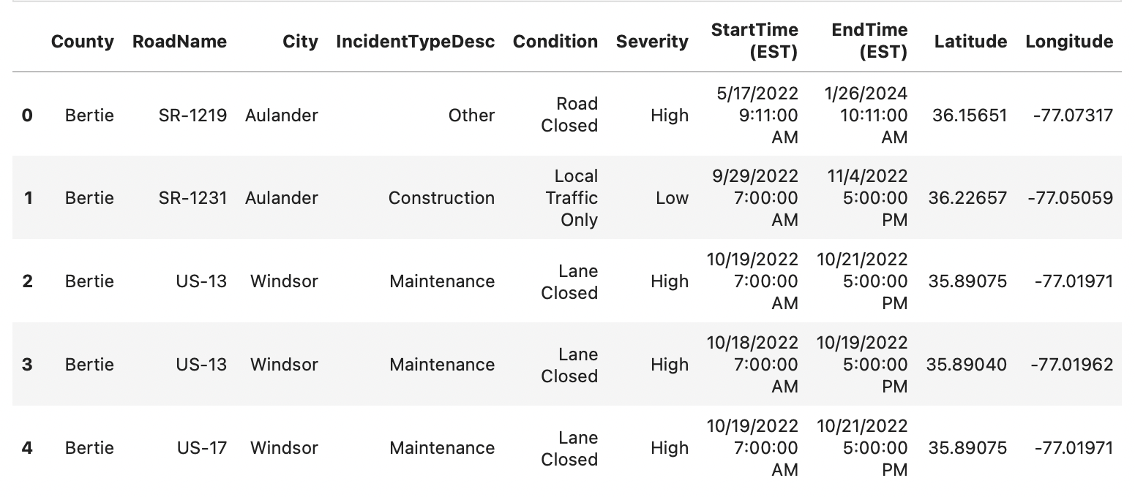
Sample of Data

Slide 6
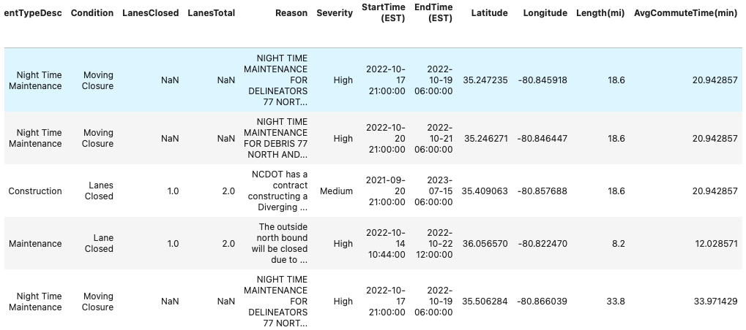

Slide 7
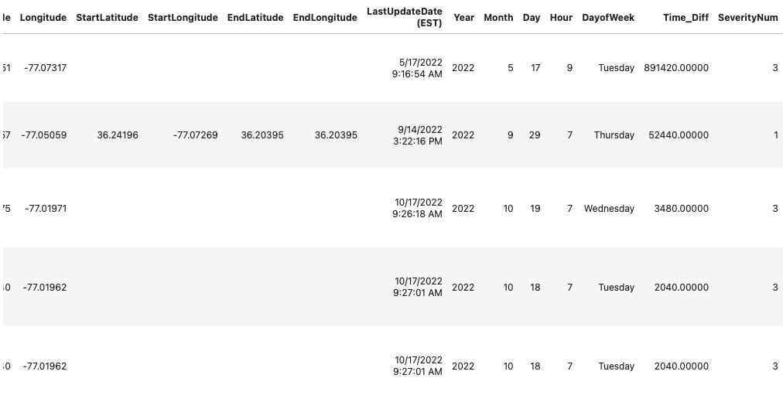

Slide 8
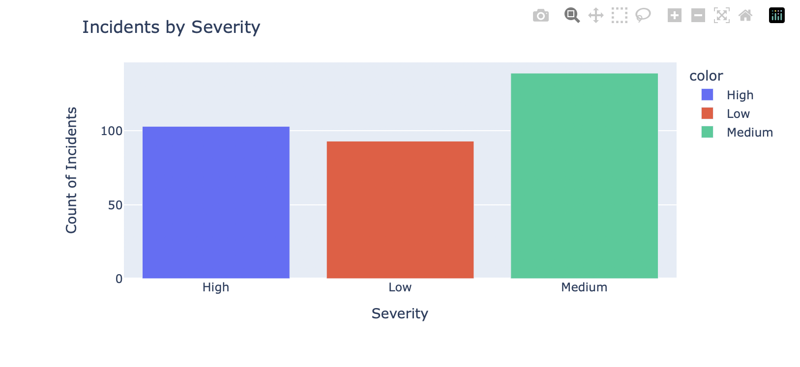

Slide 9
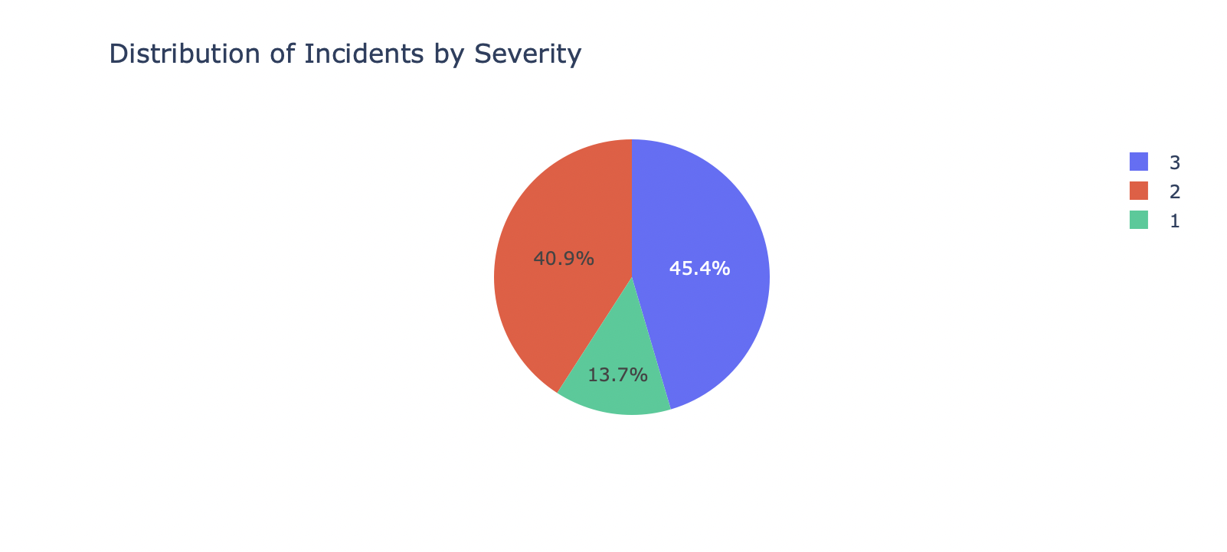

Slide 10
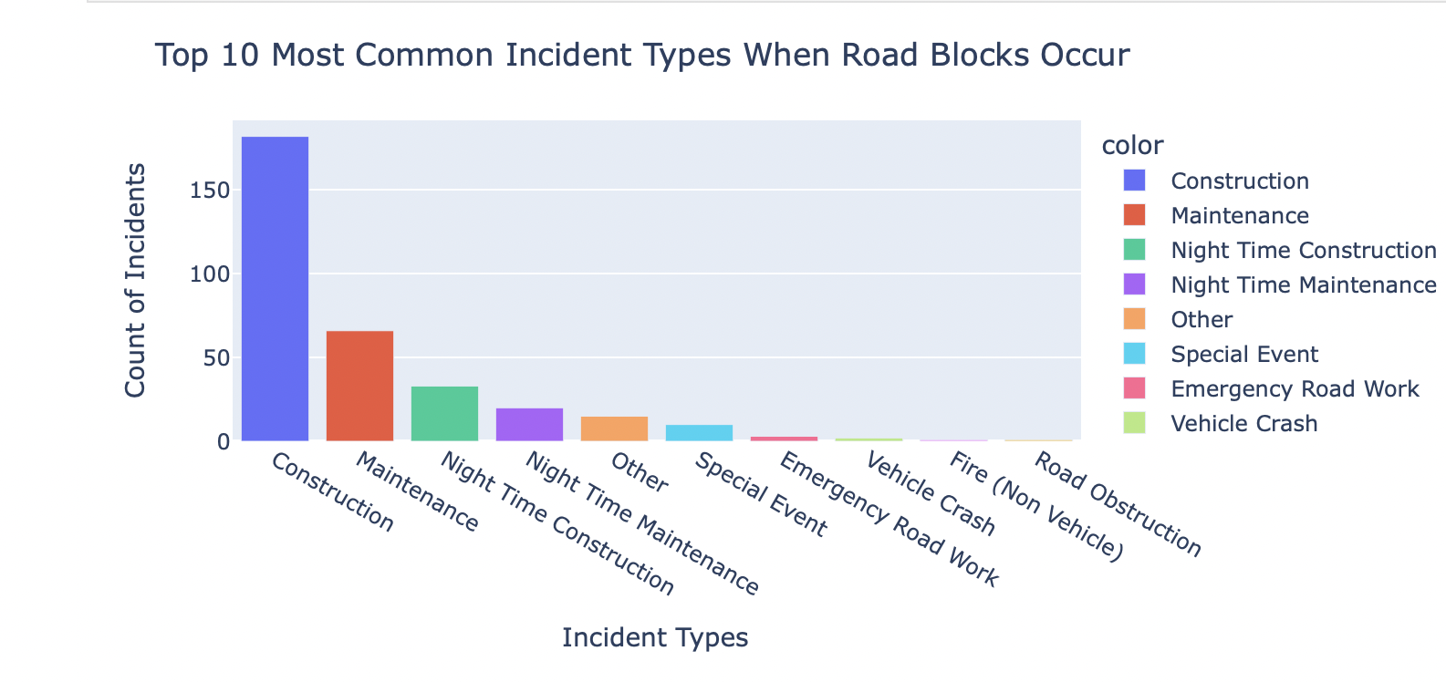

Slide 11
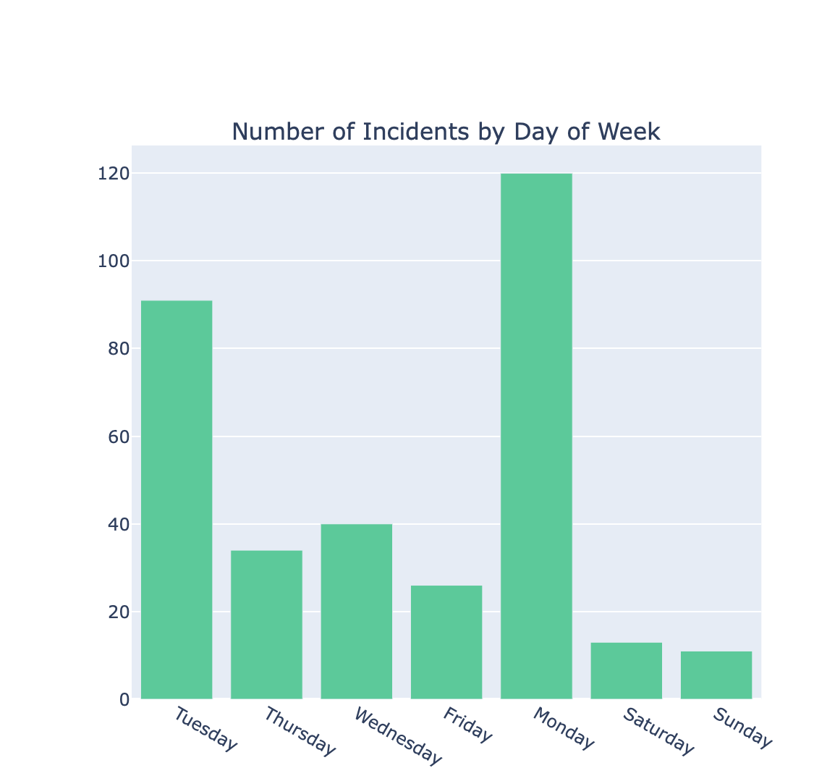

Slide 12
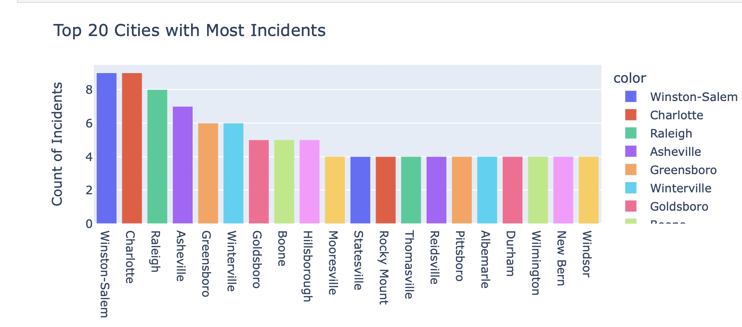

Slide 13
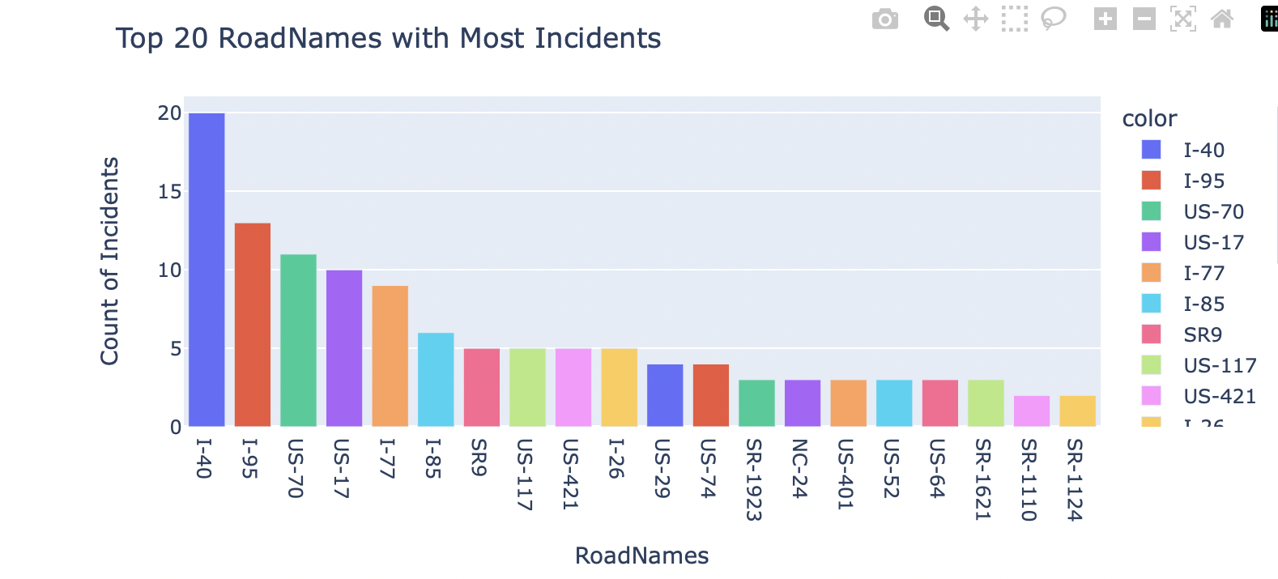

Slide 14
Conclusion
Day time construction accounts for most traffic delays seen in North Carolina.
Winston Salem account for most incidents in North Carolina
Most road incidents have High Severity time Delays, meaning that commute times will be increased by 40 minutes
Our Random Forest Model contains many Decision Trees which allowed us to conclude that beginning shipping routes on SR-1124 on Sundays at 5am would provide the least amount of traffic delay. With this information freight companies would able to know exactly when to begin their shipping routes out of Charlotte. We also found that if drivers begin shipping route on I-40 on Mondays at 2am they would experience the most amount of traffic delay.

Slide 15
